Slide 1
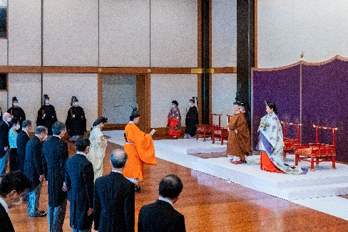
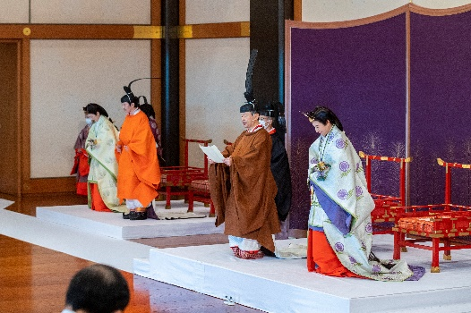
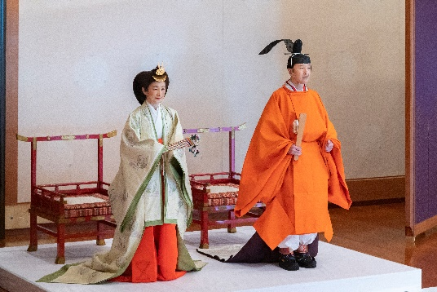
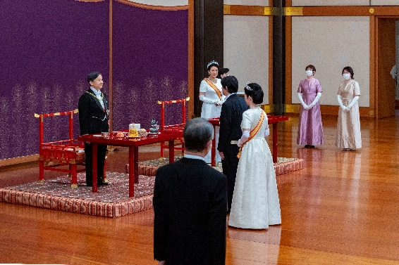
Ceremonies for Proclamation of Crown Prince
Ministry of
Foreign Affairs
of Japan
One year after the Ceremonies of Accession to the Throne of His Majesty, the 126th Emperor, the Ceremonies for Proclamation of Crown Prince were held at State Hall of Imperial Palace on November 8th, 2020 (2nd year of Reiwa).
Rikkoshi-Senmei-no-gi
(Ceremony for Proclamation of Crown Prince)
Ceremony to proclaim that Prince Akishino has become the Crown Prince and for the representatives from home and abroad to express felicitations.
【Address by His Majesty the Emperor】
Today, I hereby perform the Rikkoshi-Senmei-no-gi, Ceremony for Proclamation of Crown Prince, in accordance with the Imperial Household Law, and proclaim to those at home and abroad that Prince Akishino is Crown Prince.
【Address by His Imperial Highness Crown Prince Akishino】
I am filled with the deepest awe and gratitude at being proclaimed the Imperial Heir, Crown Prince, at this Ceremony for Proclamation of Crown Prince.
I will discharge my duties solemnly bearing in mind my responsibilities as Crown Prince.
Choken-no-gi (First Audience)
Ceremony for the Emperor and Empress to meet the Crown Prince for the first time after the Ceremony for Proclamation of Crown Prince.
Ceremony for Proclamation of Crown Prince
His Majesty the Emperor (Brown Costume) and His Imperial Highness Crown Prince Akishino (Orange Costume, center)
His Majesty the Emperor (Brown Costume) and His Imperial Highness Crown Prince Akishino (Orange Costume)
His Imperial Highness Crown Prince Akishino and Her Imperial Higness Crown Princess Akishino
First Audience

